Slide 1


UT Austin Bhakti Yoga Club
President – Vignesh Kumar
Student Rep – Hari Kosuru
Ex-president – Nishtha Sharma
Speakers
Primary - Gaura (Girish)
Others – Lavanya and Sarva

Slide 2



Slide 3



Schedule & details
Every Thursday
Time 7.30-9pm
Room CBA 4.344 for 2017 (TBA for 2018)
FREE of cost
Exclusively for UT students and staff
Case by case basis for non-UT members
Bring your friends
Check Facebook and Google group emails for weekly updates
Email – utaustinbyc@gmail.com

Slide 4
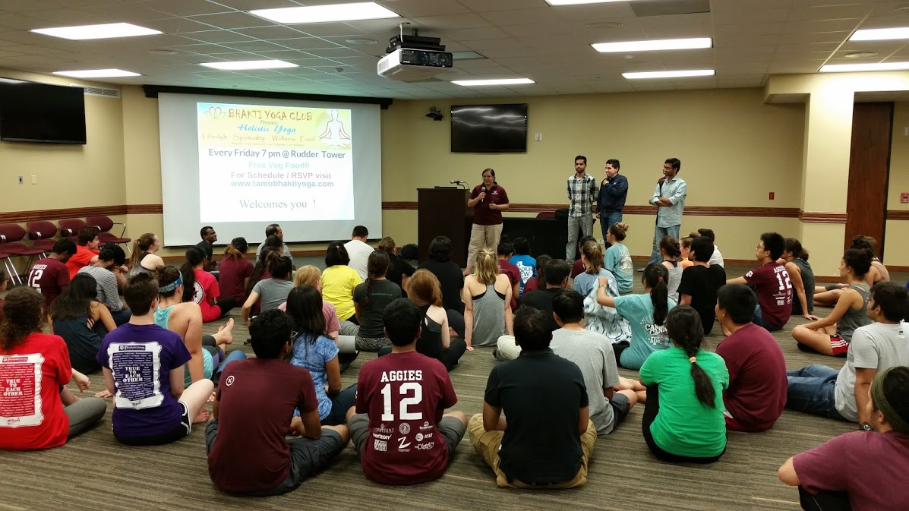
Texas A&M

Slide 5
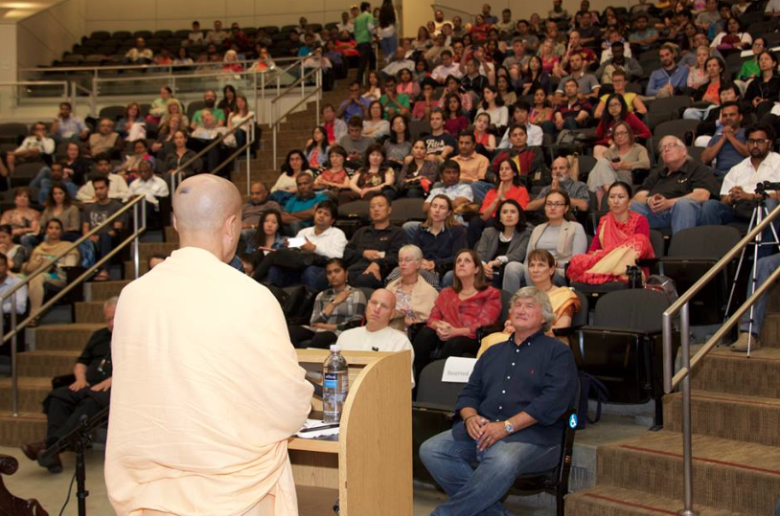
Stanford

Slide 6
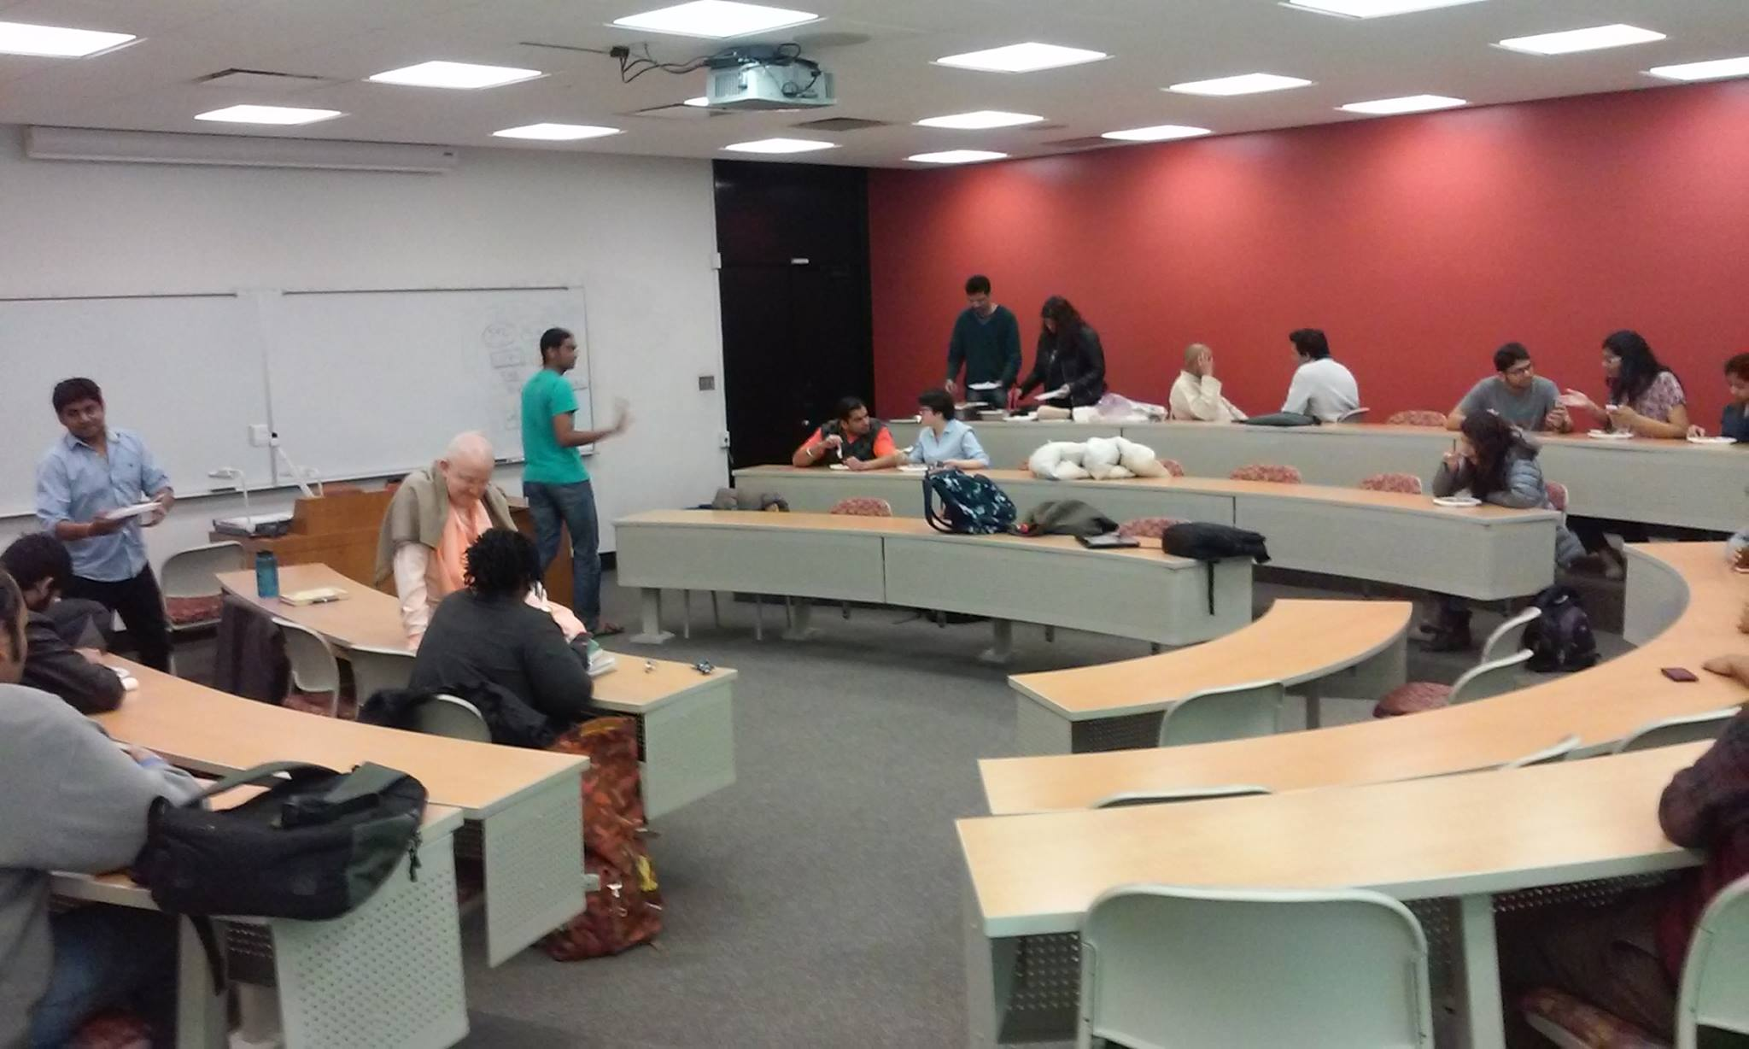
IIT Chicago

Slide 7

Virginia

Slide 8
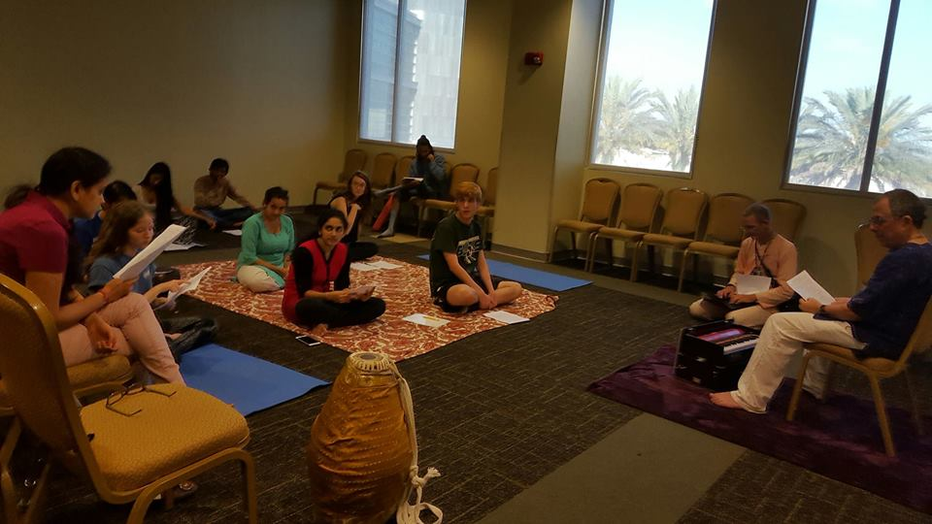
University of South Florida

Slide 9
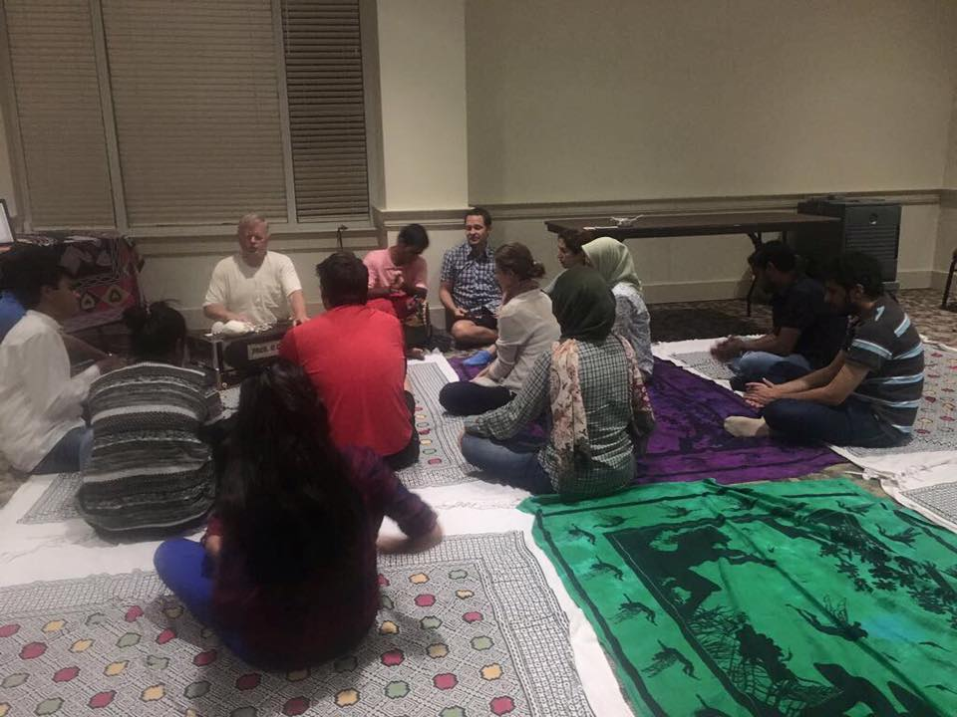
Baltimore

Slide 10
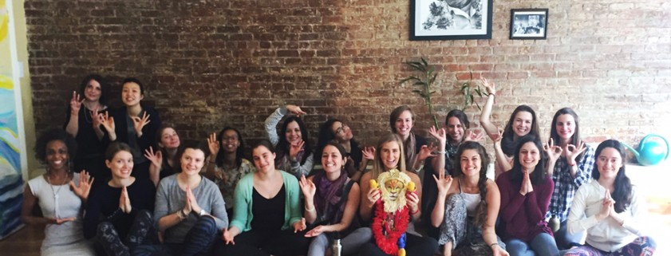
Washington DC

